Slide 1
Unit - III
Agile Modelling and XP

Slide 2
Introduction
The fit
Common practices
Modelling specific practices
XP objections to agile modelling
Agile modelling and planning XP projects
XP implementation phase.

Slide 3
Introduction
Agile modeling is a collection of practices and principles that can be used to model software, and Extreme Programming (XP) is a software development methodology that's based on Agile principles
Both are from the agile concept and both are motivated by the desire to produce better software faster.
What is the relationship between Agile Modelling and XP? Are they complementary or contradictory?

Slide 4
The fit
Many of the Agile Modelling practices fit straight into XP - modelling equivalent of the XP programming
Agile Modelling’s emphasis is modelling and XP’s is programing.
so there are differences and there are practices that are only relevant to one of the methods or the other.

Slide 5
The fit
Do the Agile Modelling practises add any value to the XP practises.
Whether Agile Modelling actually fits in with the philosophy of XP
Main conflict that can come across is –
- XP do not need to concentrate more on modelling where as
- Agile modelling mainly concentrates on modelling methodologies.

Slide 6
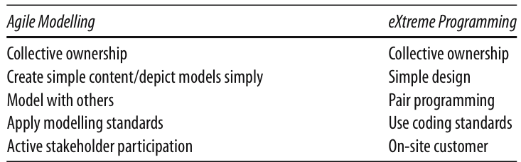
Common practices
This table pairs up various Agile Modelling practices with their equivalent (or near-equivalent) XP practices

Slide 7
Common practices
There is bound to be a slight variation in emphasis within common practices.
“Model with Others” is matched to “Pair Programming” because the intention in both cases is that everything produced is examined and thought about by two or more people.
Some differences are more obvious; in Agile Modelling we use modelling standards while in eXtreme Programming we use coding standards but again the intention is the same.

Slide 8
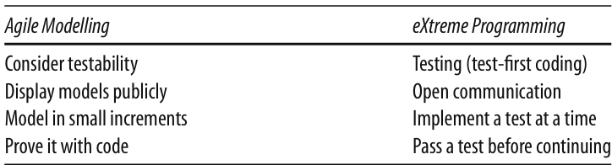
Common practices

Slide 9
Common practices
Other Agile Modelling practices have potentially less obvious parallels within XP practices. But again if they are examined, it can be seen that they represent the same or similar intention but from the modelling perspective.
For Example when performing Agile Modelling you should con sider how what you are modelling might be tested, How you can model to facilitate testing
This can be then fed into the test-first coding style of XP

Slide 10
Common practices
Agile Modelling also encourages modelers to work in “small increments” that is similar to XP’s practice of defining a single test, implementing what is needed for that test, before continuing with the next test.
Finally, one way of validating models created in Agile Modelling is to prove those models by implementing them. This is similar to requiring code to pass an individual test before continuing.

Slide 11
Modelling specific practices
There are some Agile Modelling practices that may, appear to have no place within XP at all. These practices are
Model with a purpose
Using multiple models
Know your models.

Slide 12
Modelling specific practices
Model with a Purpose –
Model to understand the software –
This is relevant because, before you refactor or extend your code you must understand it.
It may require reviewing how the instances of the classes are created, interacted and are discarded.
It is easier to use diagrams and pictures than by purely examining the source code.
For example, when looking at part of the implementation of the tool developed by a colleague, I need to become familiar with the structure of the main tool.
Not all the time but in some cases we need to take help of software to find out the structure of the code.

Slide 13
Modelling specific practices
Model to communicate
Source code is the end result that we all are trying to produce, However, it is not the best way to explain your ideas to one or more other people
Within XP, if a new piece of code is to be implemented, a programmer may call a quick “stand-up” meeting to run through their ideas with their pair-programming partner
At such a meeting, models may well be the best form of communication. Of course, this does not necessarily imply the use of a modelling tool. It may involve white boards, post-it notes, index cards, etc. But then, that is exactly what Agile Modelling encourages you to use
The key to both of these issues: “Model to understand” and “Model to communicate,” is the need for a “valid purpose.” Stating that XP does not explicitly include modelling is not a valid reason for not to do modelling. Even in XP, there can be “valid reasons” to model

Slide 14
Modelling specific practices
Using multiple models
If you wish to fully understand your application, then you may well need to consider a class diagram (for the system structure), a sequence diagram (for its behavior), a data diagram (for the database representation), etc.
This is still as true for XP as it is for Agile Modelling! You should then switch between the different models as and when required

Slide 15
Modelling specific practices
Know your models
Whether you are an Agile modeler or an XP developer you need to know the tools available to you.
Even for those working on an XP project, modelling is relevant (as has already been said). Thus, XP developers need to understand the models available to them just as much as an Agile modeler should.
That is, they should understand the strengths and weaknesses of different types of models.
This will help them to keep models as simple as possible, as well as helps to apply appropriate models which will help them to understand the systems under consideration.

Slide 16
XP objections to agile modelling
Arguments raised by XP practitioners against Agile Modelling include
Modelling is all about big up-front design
“Model in Small Increments” and “Prove it with Code.”
All models are permanent documents
The practices “Discard temporary models,” “Use the simplest tools” and "Update only when it hurts” contradict this view.
You need to use a complex modelling tool,
use whatever modelling medium is appropriate.

Slide 17
XP objections to agile modelling
You need to know, and use, UML to create models.
focus on the audience of what they are creating and make sure that it is comprehensible to that audience.
XP does not encourage modelling.
The use of index cards for user stories and classes is a form of modelling.
XP practitioners will also often draw diagrams on white boards while trying to consider how to address a problem of refactor code, etc. These are again forms of models.

Slide 18
XP objections to agile modelling
XP does not create any documentation
XP promotes code as the core form of documentation for a system as only code is in sync with code.
In some cases, models may be a very useful form of documentation for non programmers. For example, a UML deployment diagram may be very useful for understanding how the system will be installed over a network.

Slide 19
Agile modelling and planning XP projects
Here we will consider how and where Agile Modelling fits into the project-planning aspects of an XP project
An XP project is planned at a number of levels and at various points during an XP projects lifetime
This means that Agile Modelling practices may be more or less relevant at different stages during this process.
In the following, we will consider the planning process and where Agile Modelling can be exploited to the benefit of XP

Slide 20
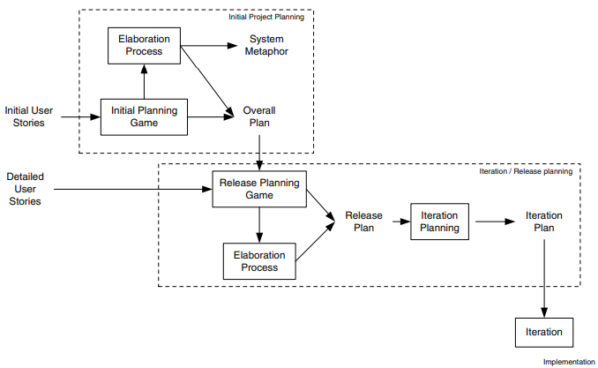
Agile modelling and planning XP projects

Slide 21
Agile modelling and planning XP projects
Initial Project Planning
There are two primary steps within the initial project-planning phase; these are the Initial planning game and the Elaboration process
Elaboration process.
During the elaboration process, various models may be created to help the developers understand what will be required of the system. This will help to produce better estimates, etc. Again Agile Modelling practices can be of great help here.

Slide 22
Agile modelling and planning XP projects
Initial planning game.
During this process, business and development may resort to modelling to help them clarify the user stories. By applying Agile Modelling practices, this modelling can be controlled and focused.
An example of where they might do this is when a User Interface mock up might be created, with some simple flow charts to prototype system behavior as a way of elaborating a user story.
A diagram can be drawn on a white board to consider what fields are needed and what will happen when a user selects the submit option. The flow diagram can be presented to express what happens when the submit button is pressed.

Slide 23
Agile modelling and planning XP projects
Iteration/Release Planning
During the iteration/release planning stages, modelling is again important.
Release planning game. As with the initial planning game, Agile Modelling practices can help focus the modelling activities used to clarify user requirements.
Elaboration process. Although this is typically a shorter process than for the initial project planning phase, some modelling often still takes place and Agile Modelling can be applied to ensure that modelling does not become a burden.
Iteration planning. In order to break down user stories into tasks, it may be necessary to model how the user stories might be implemented. This might involve initial class structures, behavior, etc. This can allow tasks to be identified, clarified or split up. Note that this is not large up-front design, as the models may be discarded and may only be intended to help elaborate the tasks.

Slide 24
XP implementation phase
Implementation Phase is where the code actually gets written within an XP project.
There are various points at which a model may be relevant and therefore Agile Modelling practices may be applied
Agile Modelling can complement several implementation-oriented practices of XP. Such as “Test-first coding,” and “Refactoring”.
The practices to be looked are:
Refactoring,
Test-first coding,
Simple design and
Pair programming.

Slide 25
XP implementation phase
Refactoring
Refactoring is primarily a code improvement technique; it is compatible with agile modelling activity.
some of the issues to consider when refactoring are
- Make sure you know how to improve the code.
- Make sure what you have done has improved the code
By applying Agile Modelling practices, it can be determined if the models actually need to be revised or not by considering the following two Agile Modelling practices
-Update only when it hurts not to do so.
- Discard temporary models.

Slide 26
XP implementation phase
Test-first coding
Write a test.
Write the code to be tested.
Run the test/get the code to work.
If the test has passed, then return to step 1 until finished
Simple design
The XP practice of simple design aims to promote the simplest implementation that will:
Run all the tests.
Has no duplicate code.
Makes it clear to anyone reading the code what it is meant to do.
Have the fewest possible classes and methods.

Slide 27
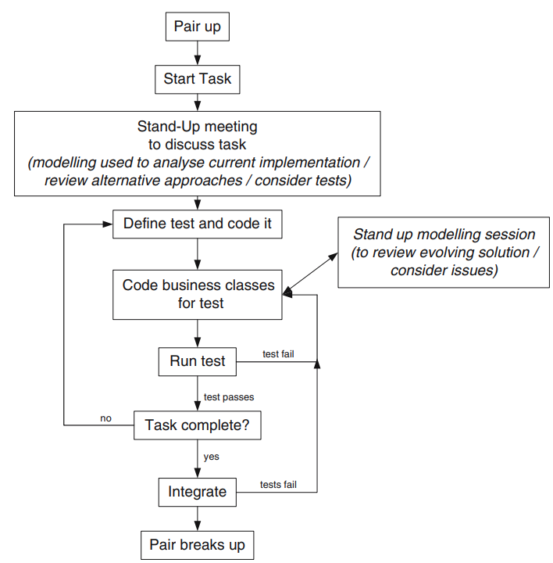
XP implementation phase

Slide 28
XP implementation phase
Pair programming
Pair programming, as we know, involves two developers working together at a single machine.
Within the pair, one developer controls the mouse and keyboard (the driver) while the other essentially monitors what the first is doing (the navigator).
It is also important that the navigator understands how the driver is intended to achieve their goals.
There are situations when these goals can be achieved merely by discussing what is to be done while sitting at the terminal
Generally it is far better to engage in a modelling session to help analyze the current software, consider alternative solutions and review how we should proceed

Slide 29
XP on Large Projects
Although most of the examples of XP projects cited appear to refer to smaller projects of less than 10 developers on projects lasting less than 6 months.
There are a number of issues relating specifically to larger projects. These are discussed below:

Slide 30
XP on Large Projects
Pair programming
Small releases.
Reviews and testing.
Architecture and simple design.
Refactoring.

Slide 31
4 Rules of Thumb
Given all of what has been said above, what can we say about where XP and Agile Modelling should be applied? There are actually a number of rules of thumb that can be identified. Note that these are rules of thumb and are not hard and fast rules. For example, XP can be and has been applied successfully to larger projects. However, it is more difficult and there is a greater potential for failure, particularly for those inexperienced in agile approaches. The rules of thumb that have emerged (and some are quite contentious)include:
Smaller projects of typically less than 10 people. The larger the project, the harder it is to manage as a pure XP project. The XP approach, that is to a large extent self- organising , becomes difficult with 20 or 30 developers involved. Of course, the team can be broken down into smaller groups and treated as smaller XP projects, but then that’s what you have, smaller XP projects interacting.
Known domain/applications. For larger projects, XP projects work best where the domain and the type of application are well understood.
Well-established architectures. This point is related to rule 2 in that the reason that XP works well in well-understood applications is that there is a (possibly) implicit architecture. The developers know what they should do where, when and how. If this is not the case, then an architecture needs to be established within which the XP project can operate.
Scalability not an issue. If scalability is an issue, it must be considered early on in the project so that it does not become an issue later on. This is typically a problem in larger, longer-lived projects where it is difficult to see the scalability issues early on. Again, an architecture may help.

Slide 32
Notes and References
Explain Common practices between Agile Modelling and eXtreme Programming (XP).
What are some specific practices for incorporating Agile Modelling into XP projects?
Agile Modeling and eXtreme Programming (XP)

Slide 33
XP objections to agile modelling
Arguments raised by XP practitioners against Agile Modelling include
Modelling is all about big up-front design Agile Modelling clearly does not promote this. This is illustrated by the Agile Modelling practices such as “Model in Small Increments” and “Prove it with Code.”
All models are permanent documents that must be updated when any changes are made. This is clearly not what Agile Modelling says. For example, the practices “Discard temporary models,” “Use the simplest tools” and "Update only when it hurts” contradict this view.
You need to use a complex modelling tool, such as Rational Rose to carry out any modelling activity. However, as Agile Modelling explicitly debunks that myth, stating you should use whatever modelling medium is appropriate, which may include modelling tools such as Rational Rose, but also white boards, index cards, post-it notes, etc.

Slide 34
XP objections to agile modelling
You need to know, and use, UML to create models. Agile Modelling does say that you should know how to apply whatever representation you are using in your models and that UML is one example of this. But it does not mandate any particular type of representation and indeed Agile modelers know that something like UML does not cover all the modelling situations you might want. In addition, an Agile modeler will not worry about creating a precise and complete UML diagram. Instead, they will focus on the audience of what they are creating and make sure that it is comprehensible to that audience.
XP does not encourage modelling. Actually this is wrong. XP does promote the creation and use of models. The use of index cards for user stories and classes is a form of modelling. XP practitioners will also often draw diagrams on white boards while trying to consider how to address a problem of refactor code, etc. These are again forms of models.

Slide 35
XP objections to agile modelling
XP does not create any documentation and models are a form of unnecessary documentation. XP promotes code as the core form of documentation for a system as only code is in sync with code. However, documentation needs to be appropriate for the reader of that documentation. Source code may be a good source of reference for programmers, but it is unlikely to be appropriate for end users, non-programmers, support personnel, etc. In some cases, models may be a very useful form of documentation for some of these audiences. For example, a UML deployment diagram may be very useful for understanding
how the system will be installed over a network.

